Slide 1
BELARUSIAN STATE UNIVERSITY
MECHANICS AND MATHEMATICS FACULTY
Department of Theoretical and Applied Mechanics
Capstone Thesis
Influence of vortex generators in a turbulent boundary layer
on local friction and transport
Student: Shevelev D. Y.
Supervisor: Chorny A. D.

Slide 2
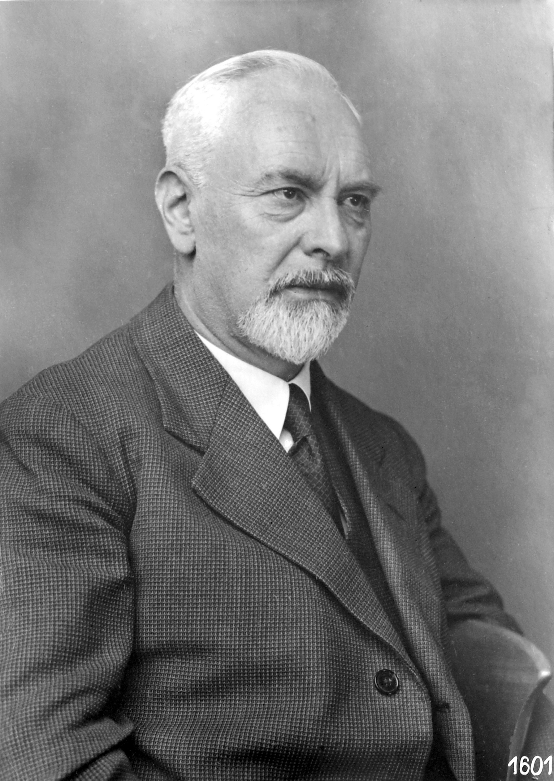
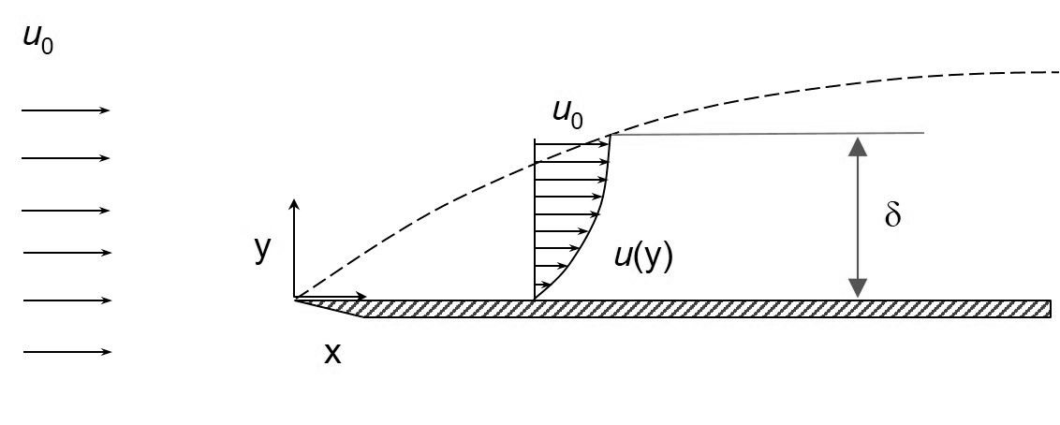
Boundary layer
The concept of boundary layer was first used on August 12, 1904 by Ludwig Prandtl in an article at the third International Congress of Mathematicians in Heidelberg, Germany.
Boundary layer - the area of the flow of a viscous fluid with a small transverse thickness compared to the longitudinal dimensions, which is formed near the surface of a streamlined solid body or at the interface between two fluid flows with different velocities or temperatures.
Ludwig Prandtl

Slide 3
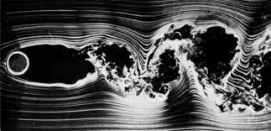
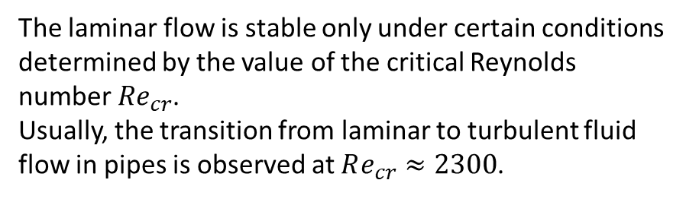
Types of flow
There are three types of flow in the boundary layer:
Laminar
Turbulent
Mixed
The laminar flow is stable only under certain conditions determined by the value of the critical Reynolds number ${Re}_{cr}$.
Usually, the transition from laminar to turbulent fluid flow in pipes is observed at $Re_{cr}≈2300$.
Example of turbulence

Slide 4
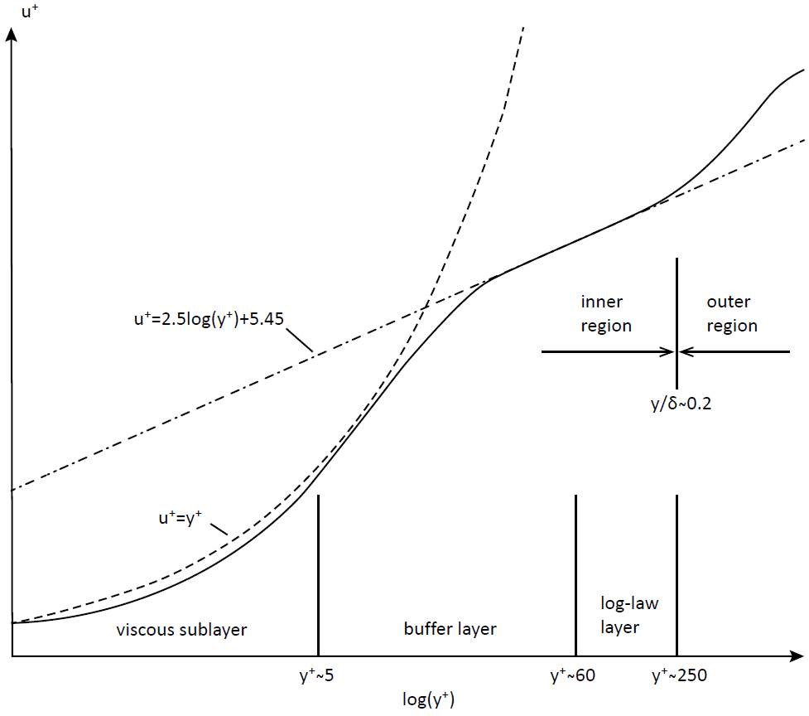
Boundary layer structure
Ideas about the structure of the velocity profile gradually changed and were finally formed by the end of the 1950s.
In a boundary layer there are two main regions. They differ from each other by different scales of vortex structures.
Outer region
Inner region
Log-law layer
Buffer layer
Viscous sublayer
The inner region of the boundary layer occupies approximately 20% of the thickness of the entire layer and generates up to 80% of the turbulence energy in it.

Slide 5
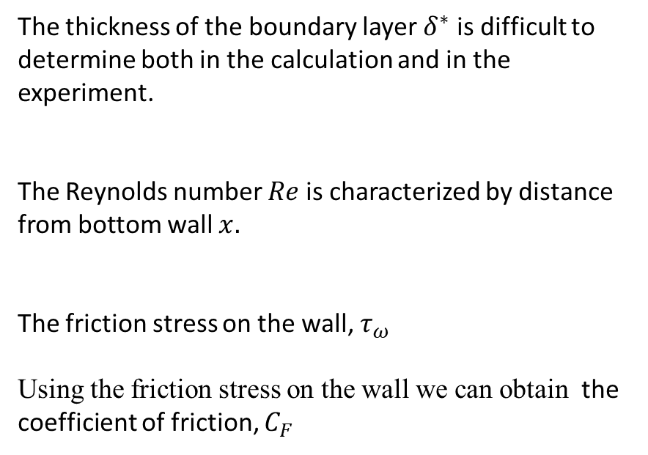

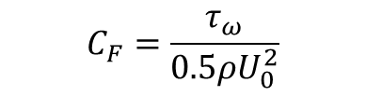
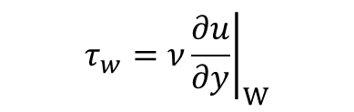
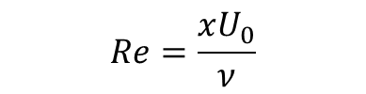
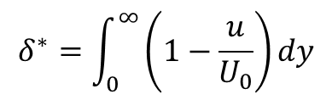
Boundary layer properties
Dimensionless quantities are usually used in order to work with the boundary layer: $u^{+}=\frac{u}{u_{τ}} y^{+}=\frac{yu_{τ}}{υ}$
The thickness of the boundary layer $δ^{∗}$ is difficult to determine both in the calculation and in the experiment.
The Reynolds number $Re$ is characterized by distance from bottom wall $x.$
The friction stress on the wall, $τ_{ω}$
Using the friction stress on the wall we can obtain the coefficient of friction, $C_{F}$
$$δ^{∗}=\int_{0}^{∞}{\left(1−\frac{u}{U_{0}}\right)dy}$$
$$Re=\frac{xU_{0}}{ν}$$
$$τ_{w}=ν{\left.\frac{∂u}{∂y}\right|}_{W}$$
$$C_{F}=\frac{τ_{ω}}{0.5ρU_{0}^{2}}$$

Slide 6
Modeling methods

Slide 7
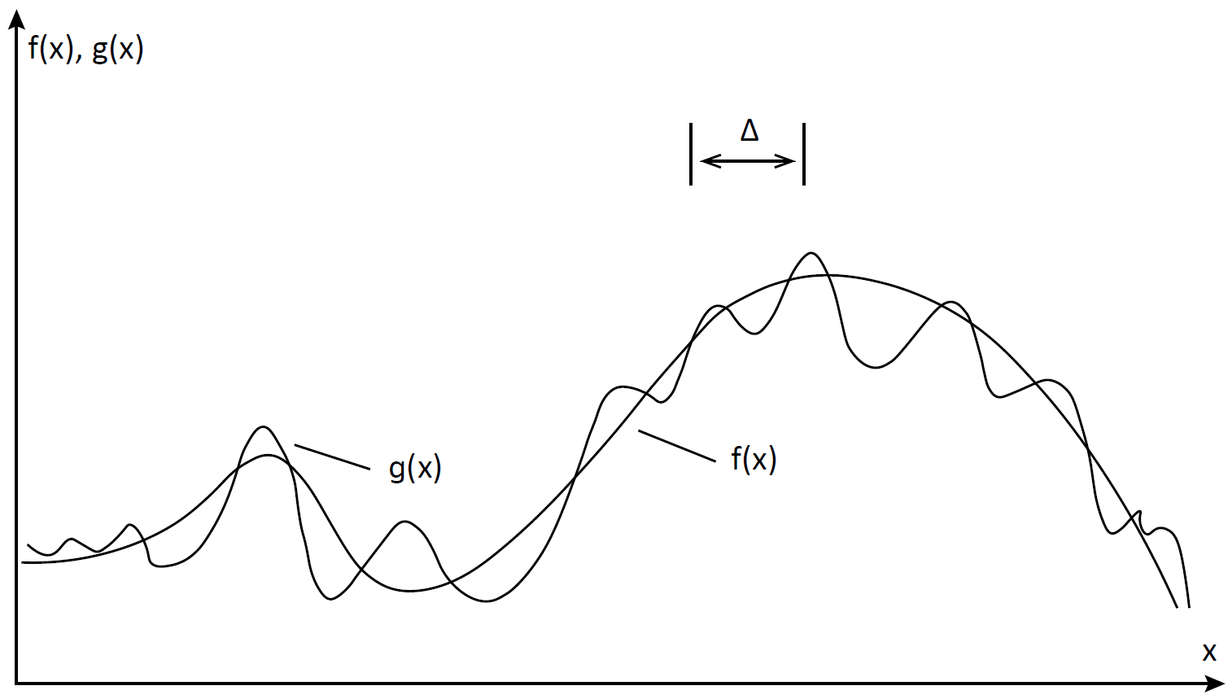
Large Eddy Simulation
LES method was proposed by Smagorinsky in 1963.
The principal idea of LES is to reduce the computational cost by ignoring the smallest length scales, which are the most computationally expensive to resolve, via low-pass filtering of the Navier–Stokes equations. This filters called sub grid scale models. The LES solution contains richer information than the RANS.
This advantages allowed to use this method in different tasks.
Example of using SGS

Slide 8
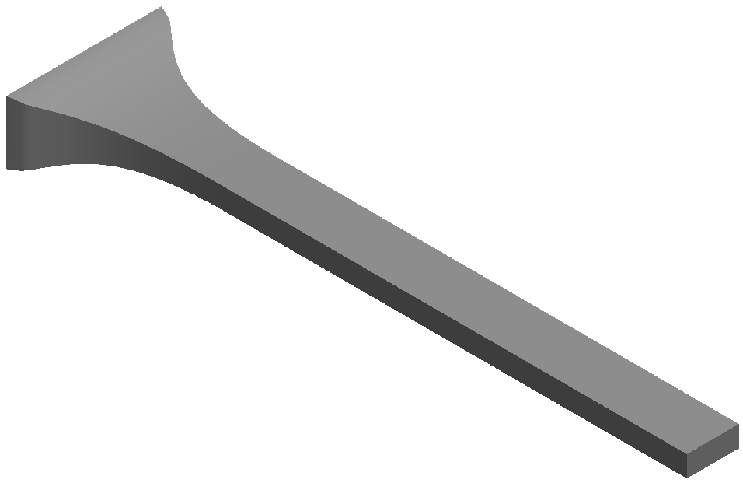
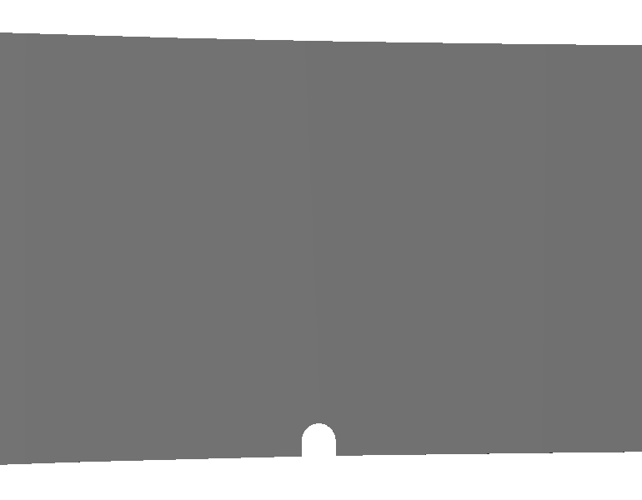
Geometry modeling
The channel is divided into two parts.
The first part with curvature Its length is 396 mm. It contains barrier, with a radius of 2.1 mm and height of 1.98 mm.
The second part is straight. Its height is 50 mm, width 124 mm and length 1100 mm.
The general length of the channel is 1496 mm. The barrier creates turbulent state.

Slide 9
Mesh
The most important part of any numerical simulation is the creation of a sufficiently detailed grid model.
A schematic plan for generating mesh was used. It helps to speed up mesh constructing and build high quality model.
Also it was found, that disabling the multithreading mode (one physical core is divided into two virtual ones) for the processor increases performance, since all the power of the core is used, and not half of it.

Slide 10
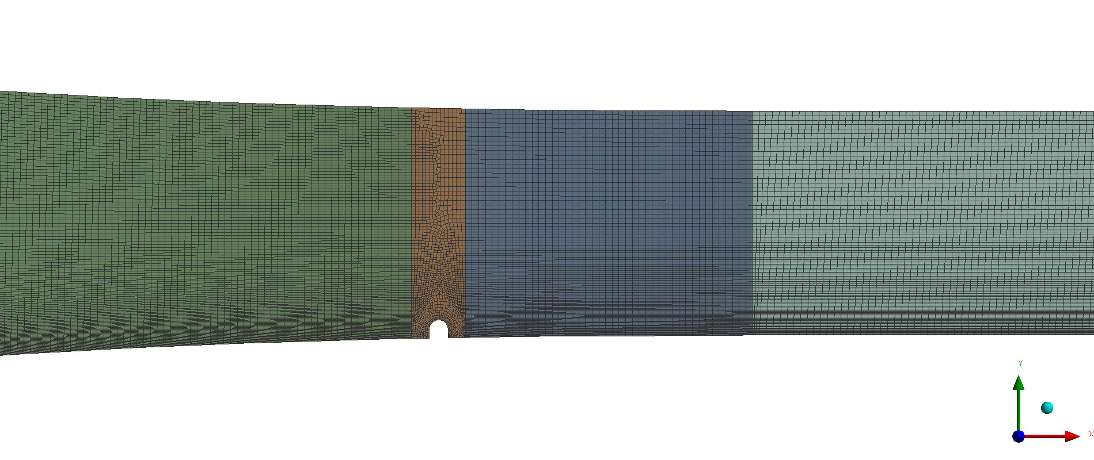
Mesh
With information mentioned earlier, was created mesh model. It helps us to achieve optimal results of calculations. The model of the channel was divided into 4 parts. Its mesh consists of 51,397,337 nodes and 12,665,608 elements.

Slide 11
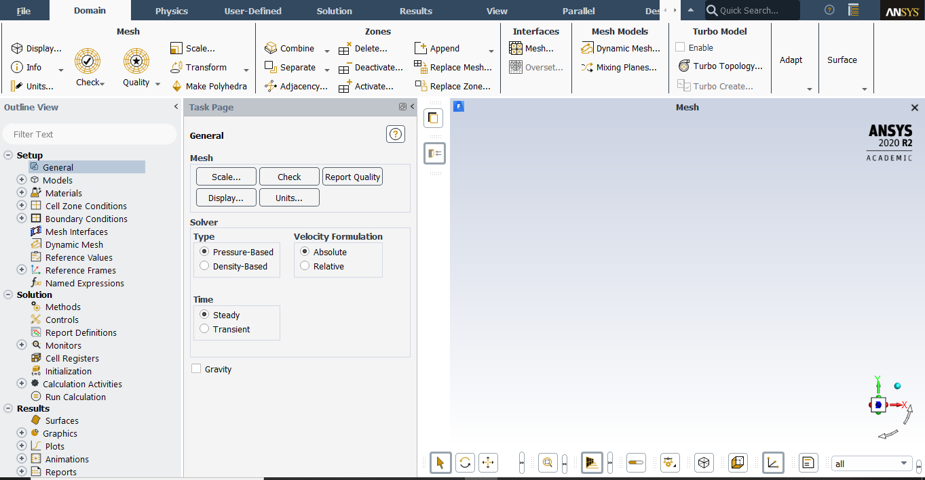
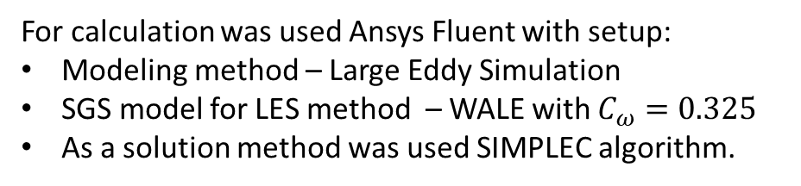
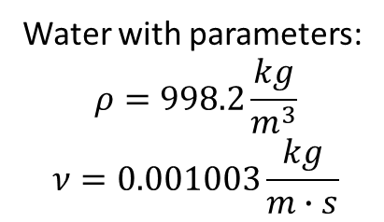
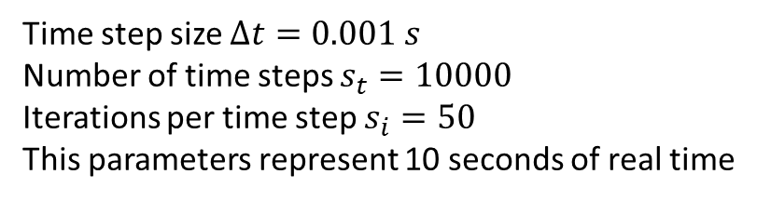
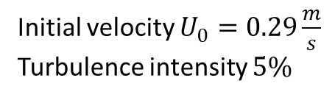
Computing
For calculation was used Ansys Fluent with setup:
Modeling method – Large Eddy Simulation
SGS model for LES method – WALE with $C_{ω}=0.325$
As a solution method was used SIMPLEC algorithm.
Water with parameters:
$$ρ=998.2\frac{kg}{m^{3}}$$
$$ν=0.001003\frac{kg}{m∙s}$$
Initial velocity $U_{0}=0.29\frac{m}{s}$
Turbulence intensity $5\%$
Time step size $Δt=0.001 s$
Number of time steps $s_{t}=10000$
Iterations per time step $s_{i}=50$
This parameters represent 10 seconds of real time

Slide 12
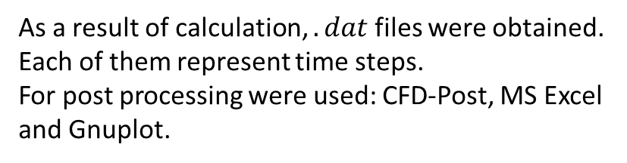
Data processing
As a result of calculation, $.dat$ files were obtained. Each of them represent time steps.
For post processing were used: CFD-Post, MS Excel and Gnuplot.
Label | Plane | Position | Description
PlaneXY | XY | Z = 0 | along the whole channel
PlaneYZ300 | YZ | X = 300 | in front of the barrier
PlaneYZ340 | YZ | X = 340 | after the barrier
PlaneYZ400 | YZ | X = 400 | begin of the straight section
PlaneYZ600 | YZ | X = 600 | further down the channel
PlaneYZ1400 | YZ | X = 1400 | at the exit of the channel
PlaneXZ0 | XZ | Y = 0 | above the boundary layer
PlaneXZ20M | XZ | Y = -20 | above the barrier
PlaneXZ23М | XZ | Y = -23 | at the barrier level
The origin of the coordinate axes of the model is located in the center of the channel entrance.
Sections were considered at different heights along and at different distances from the entrance
to the channel.
List of sections

Slide 13
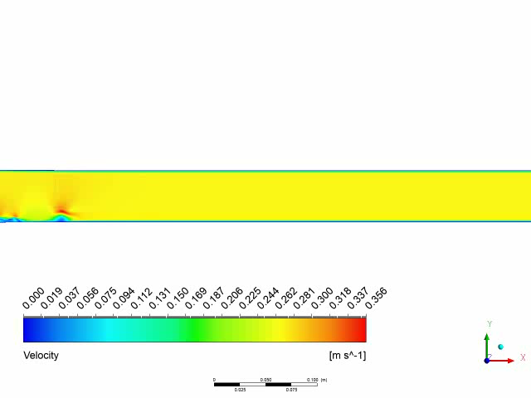
Velocity

Slide 14
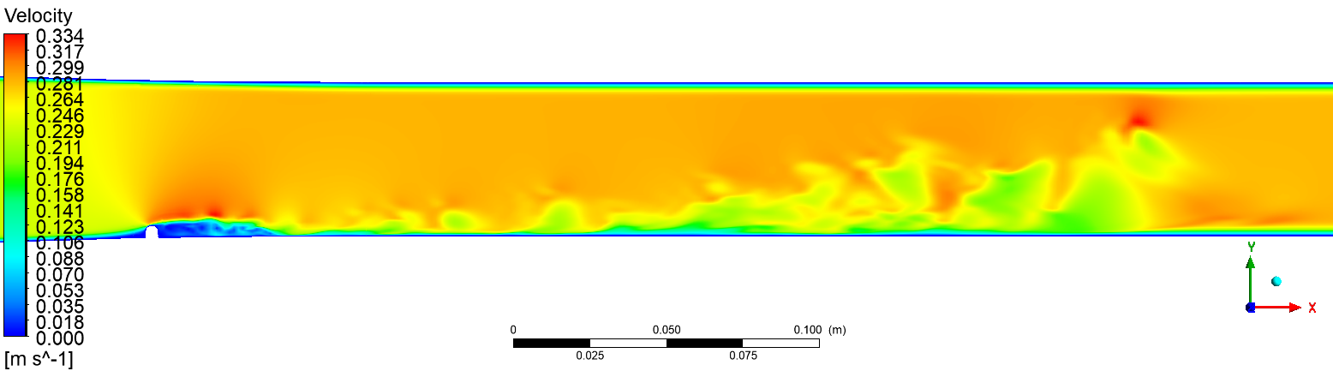
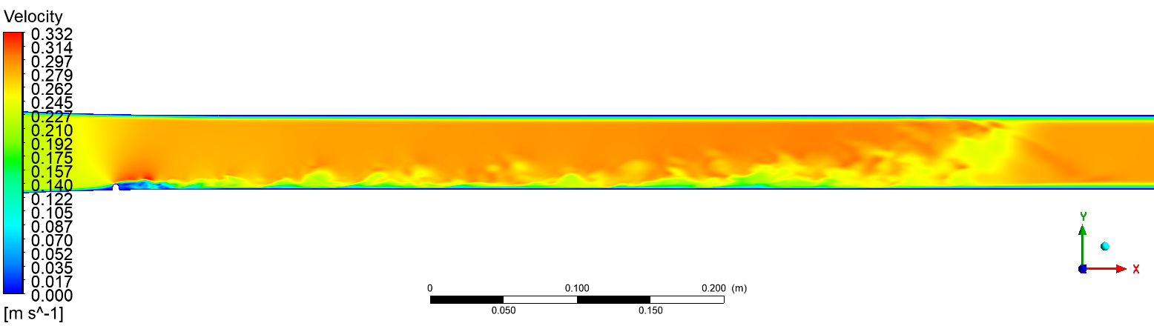
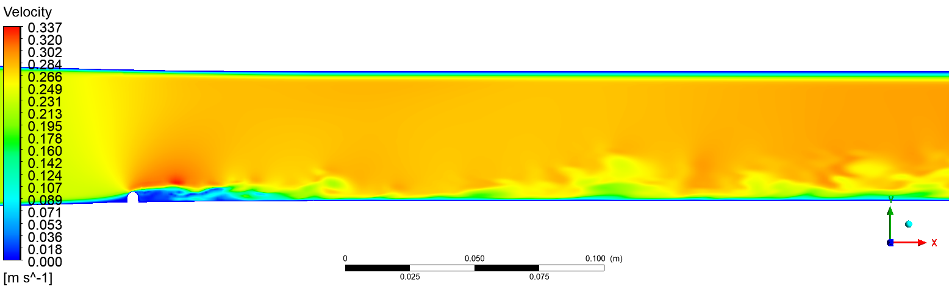



$$t=1.6 s$$
$$t=2.6 s$$
$$t=4.6 s$$

Slide 15
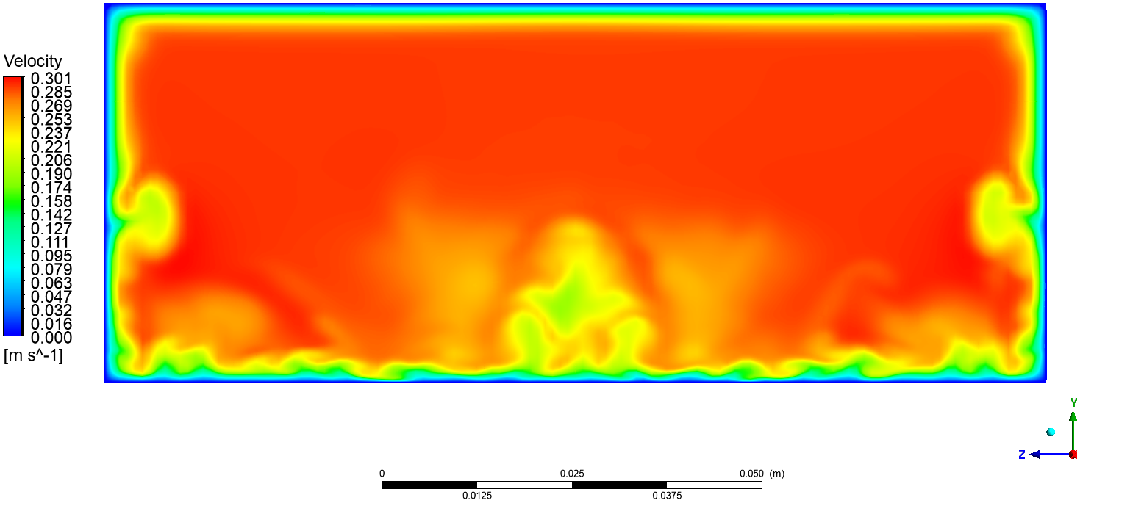
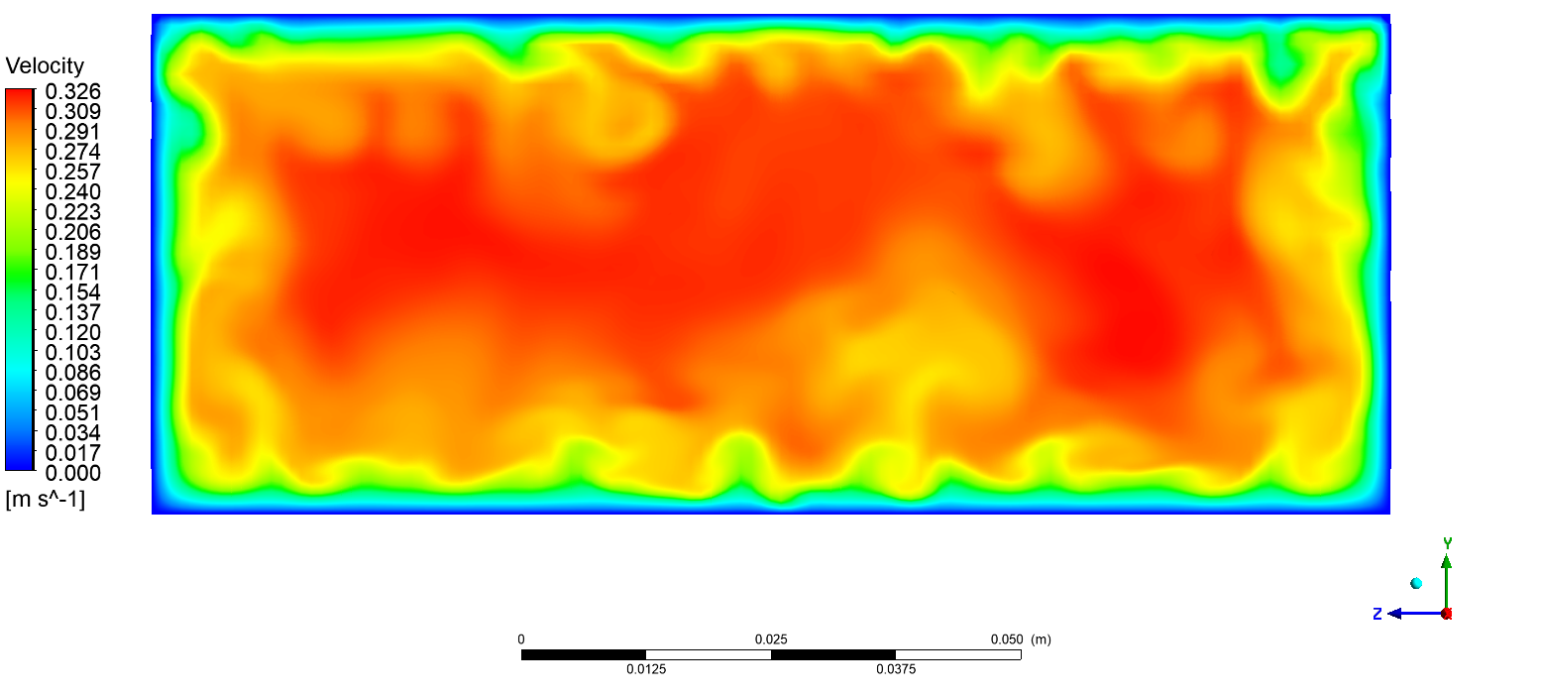
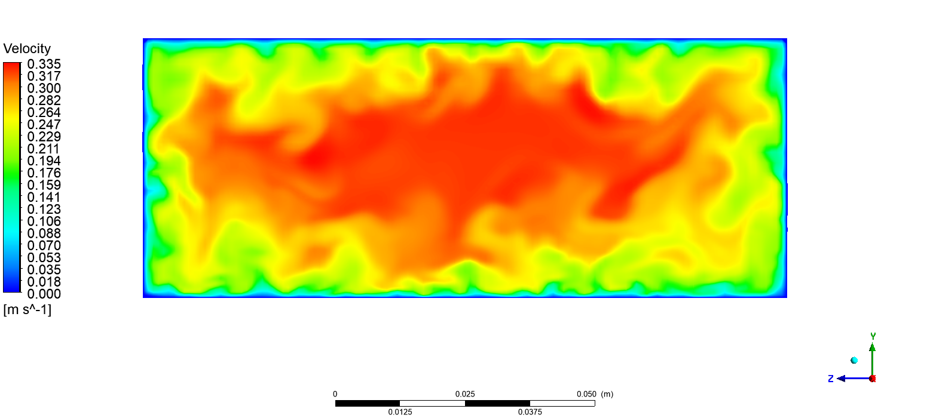
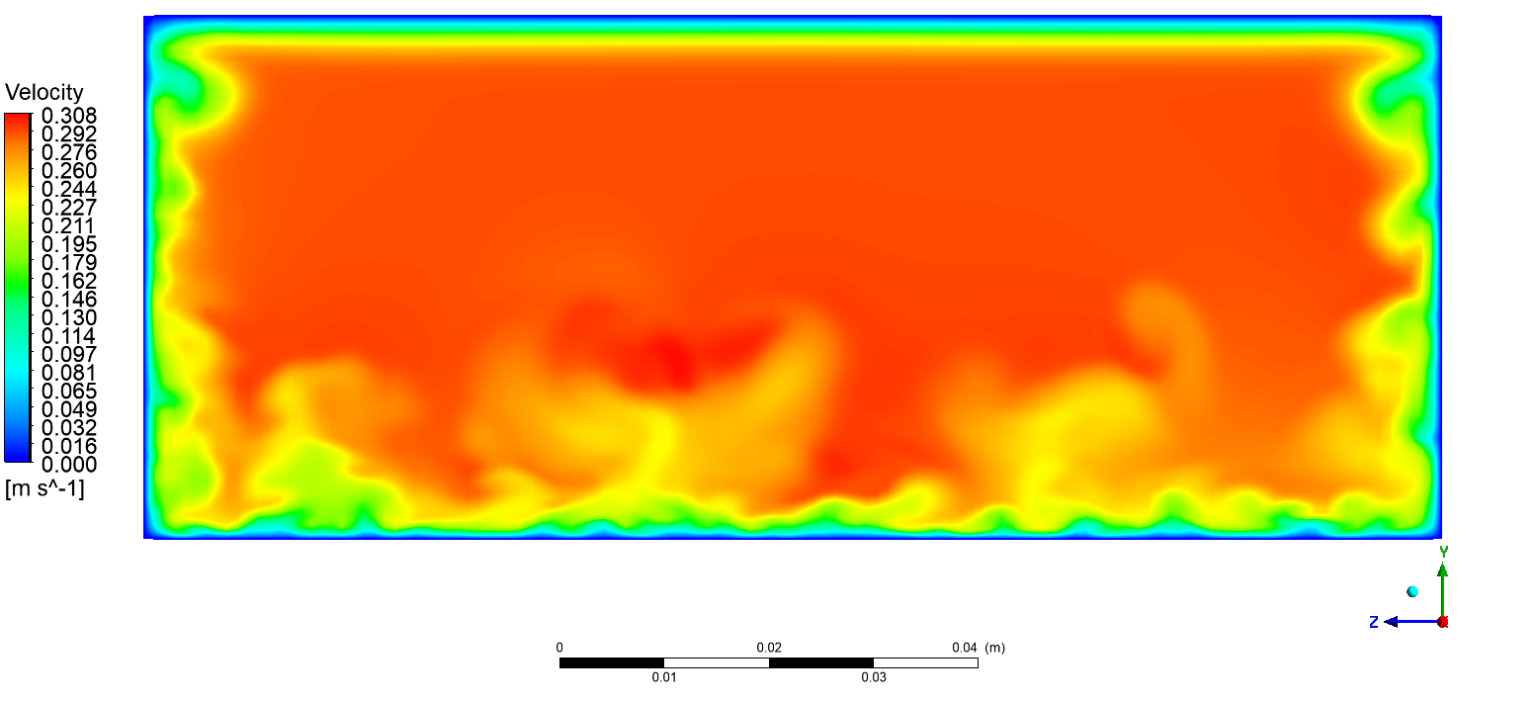
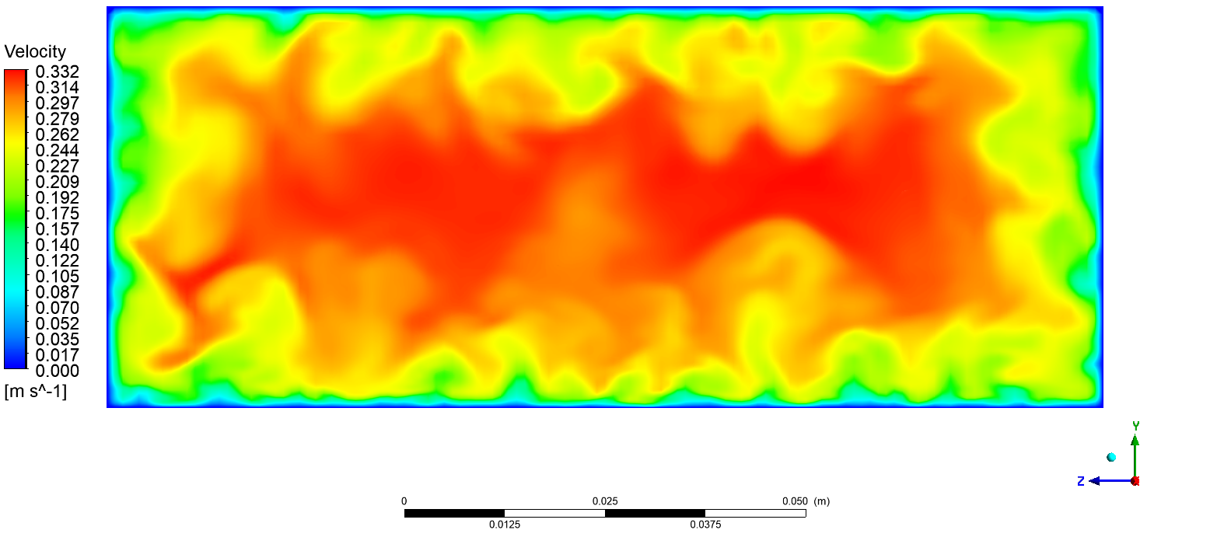
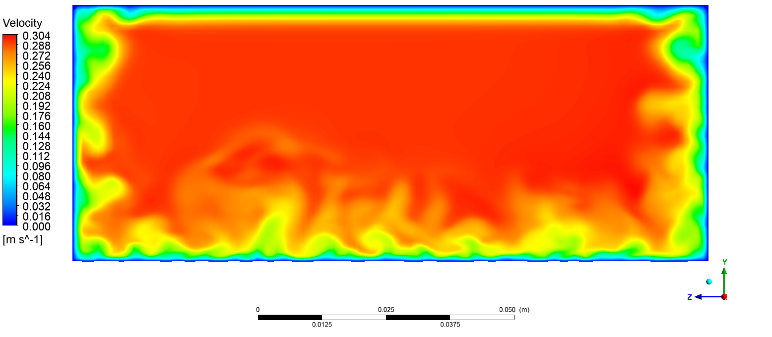






Plane YZ, x = 600 mm
Plane YZ, x = 1400 mm
$$t=1.6 s$$
$$t=4.6 s$$
$$t=5.6 s$$
$$t=2.6 s$$
$$t=3.6 s$$
$$t=6.6 s$$

Slide 16
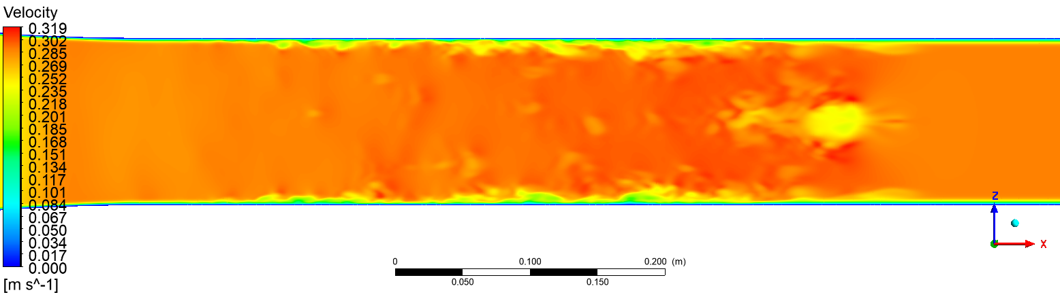
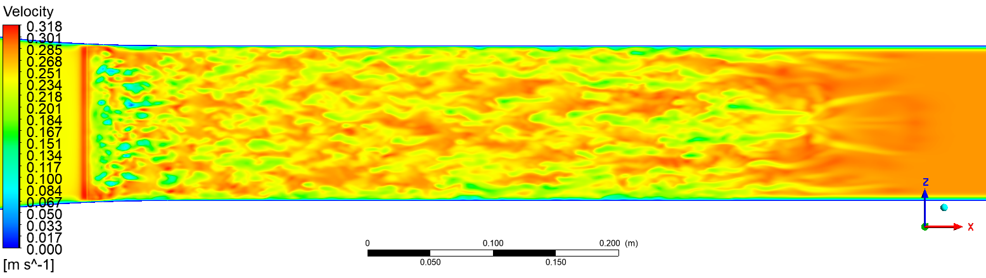
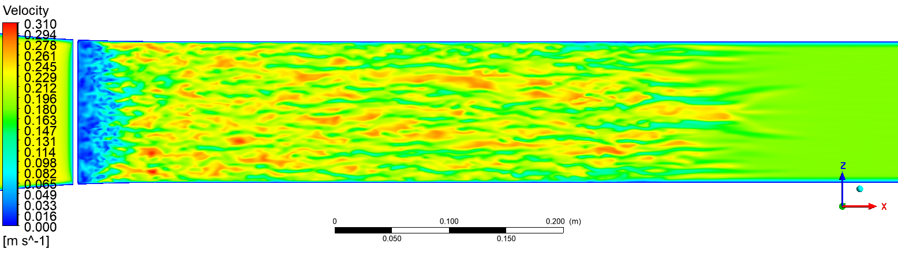
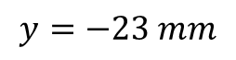
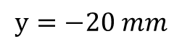
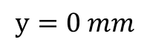
$$y=0 mm$$
$$y=−20 mm$$
$$y=−23 mm$$

Slide 17
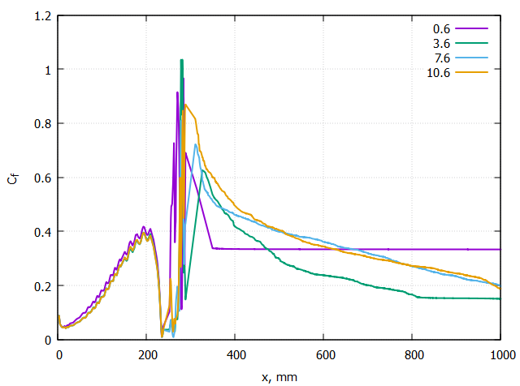
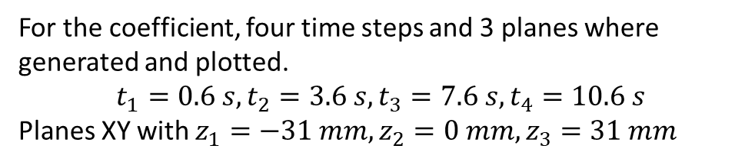
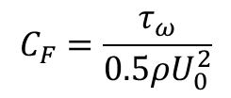

Friction Coefficient
As mentioned previously, friction coefficient can be obtained with this formula.
$$C_{F}=\frac{τ_{ω}}{0.5ρU_{0}^{2}}$$
For the coefficient, four time steps and 3 planes where generated and plotted.
$$t_{1}=0.6 s, t_{2}=3.6 s, t_{3}=7.6 s, t_{4}=10.6 s$$
Planes XY with $z_{1}=−31 mm, z_{2}=0 mm, z_{3}=31 mm$
$$Plane XY, z=0$$

Slide 18
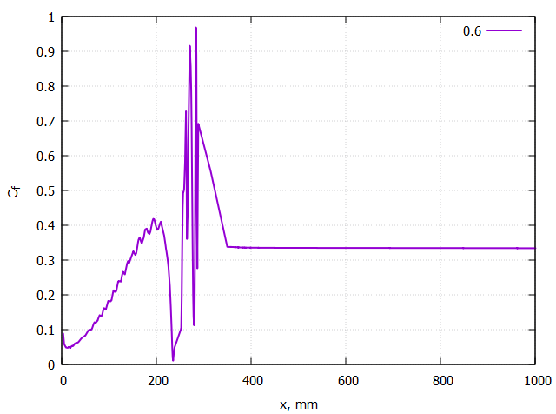
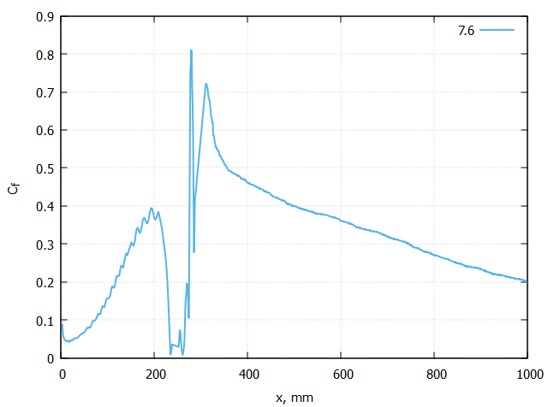


Friction Coefficient
$$z=0 mm,t=0.6 s$$
$$z=0 mm,t=7.6 s$$

Slide 19




Friction Coefficient
$$t=0.6 s$$
$$t=7.6 s$$

Slide 20


Q-criterion
Q-criterion is one of the approaches to visualize vortex flow.
It is defined as the second invariant of the velocity gradient tensor:
$$Q=\frac{1}{2}\left({\left\|Ω\right\|}^{2}−{\left\|S\right\|}^{2}\right)$$
where S – strain rate tensor and $Ω$ – rotation tensor.
$$S= \frac{1}{2}\left(\frac{∂u_{i}}{∂x_{j}}+\frac{∂u_{j}}{∂x_{i}}\right) Ω=\frac{1}{2}\left(\frac{∂u_{i}}{∂x_{j}}−\frac{∂u_{j}}{∂x_{i}}\right)$$

Slide 21




Q-criterion
Positive values of Q indicates regions in the flow where vorticity dominates and negative – strain rate or viscous stress dominates.
The less absolute value of Q, the more small vortex structures can be observed.
$$Q=860, t=1.6 s$$
$$Q=−850, t=1.6 s$$

Slide 22
Thanks for attention!

